Slide 1

Amazon Fine Food Review

Slide 2
Problem identification
Identifying Key Drivers of Customer Satisfaction
Enhanced Customer Retention:
Identifying Fake Reviews
Leveraging Data Analysis and NLP Techniques

Slide 3
Recommendation
Enhance Detection Algorithms
Implement Real-Time Monitoring
User Education
transparent review policies.

Slide 4
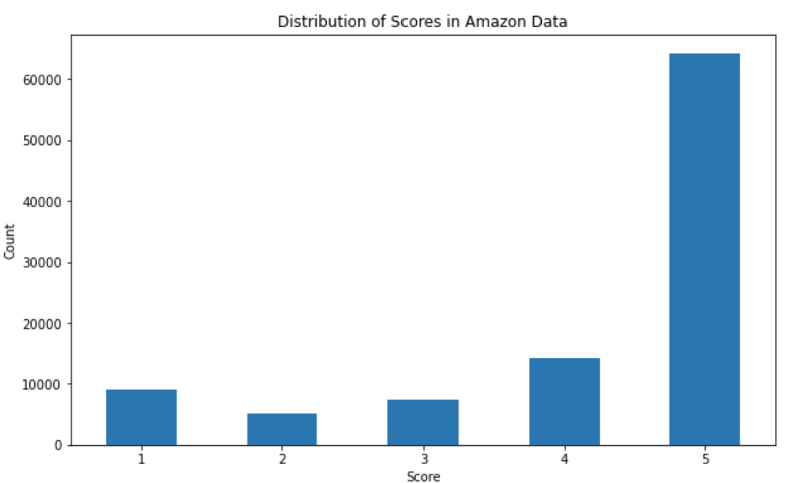
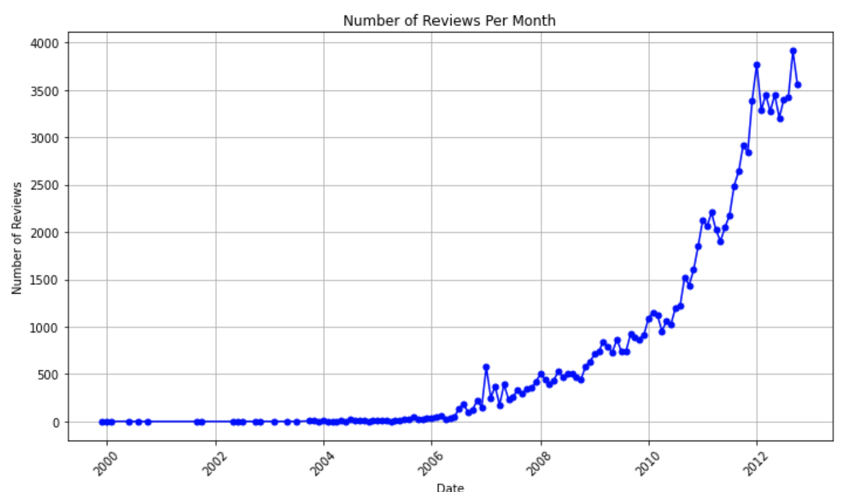
Key Findings

Slide 5
Modeling results
Models
Linear regression
Random forest
Gradient boosting machines
Neural Network

Slide 6
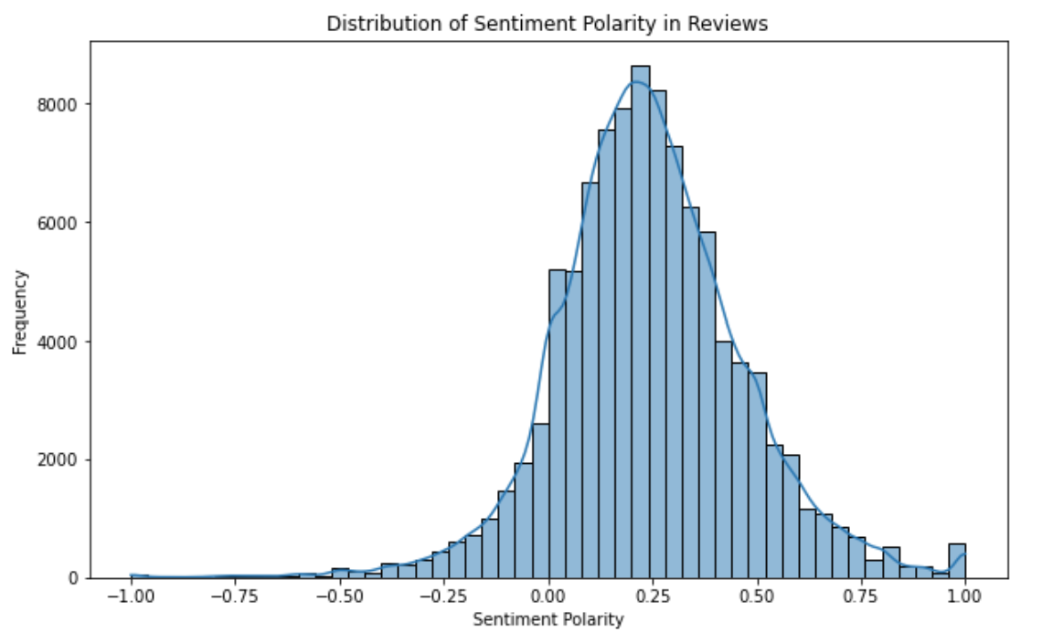
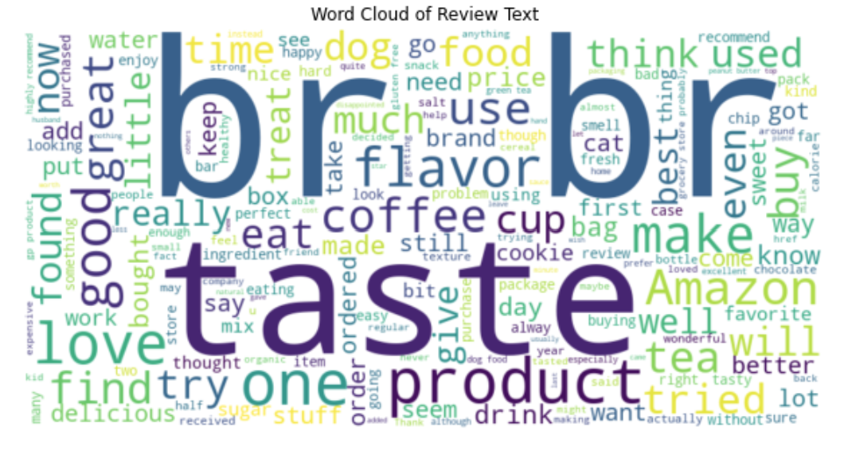
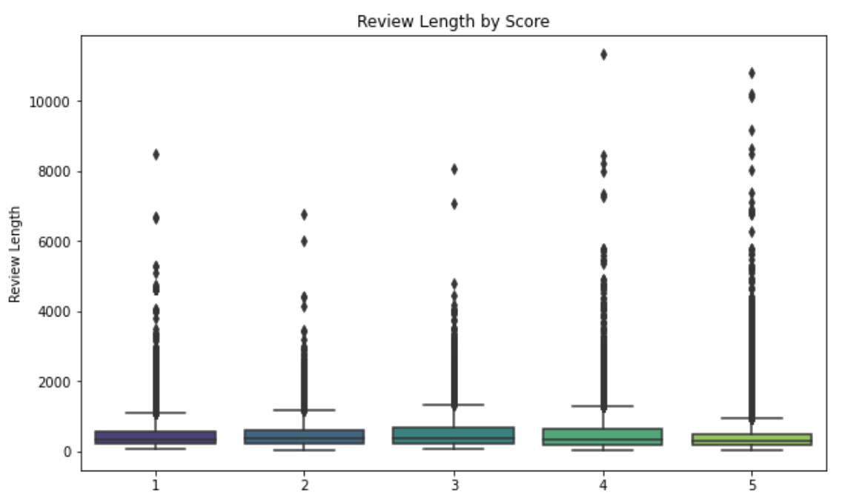
Analysis

Slide 7
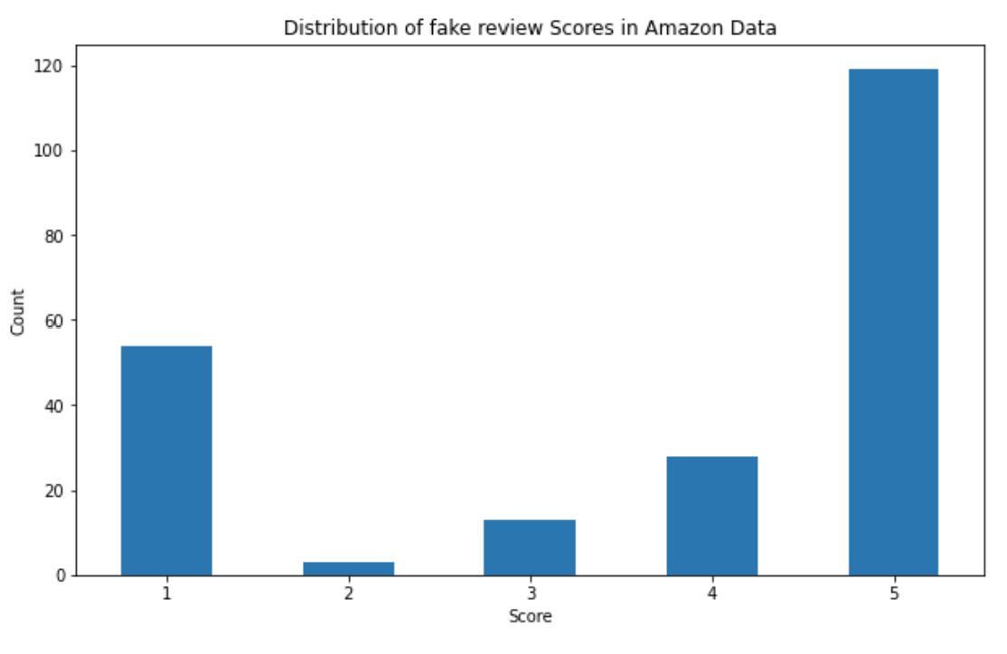
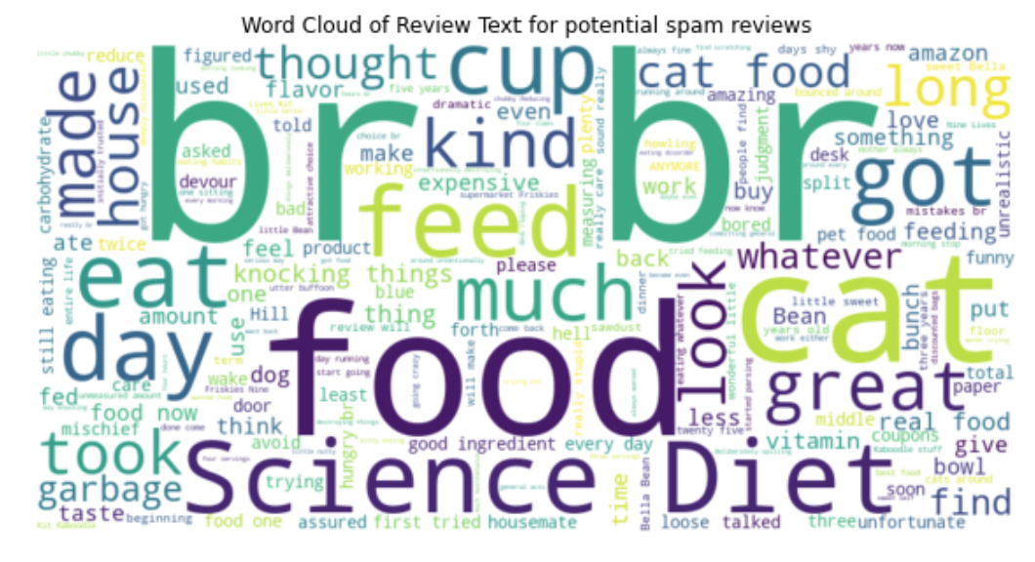
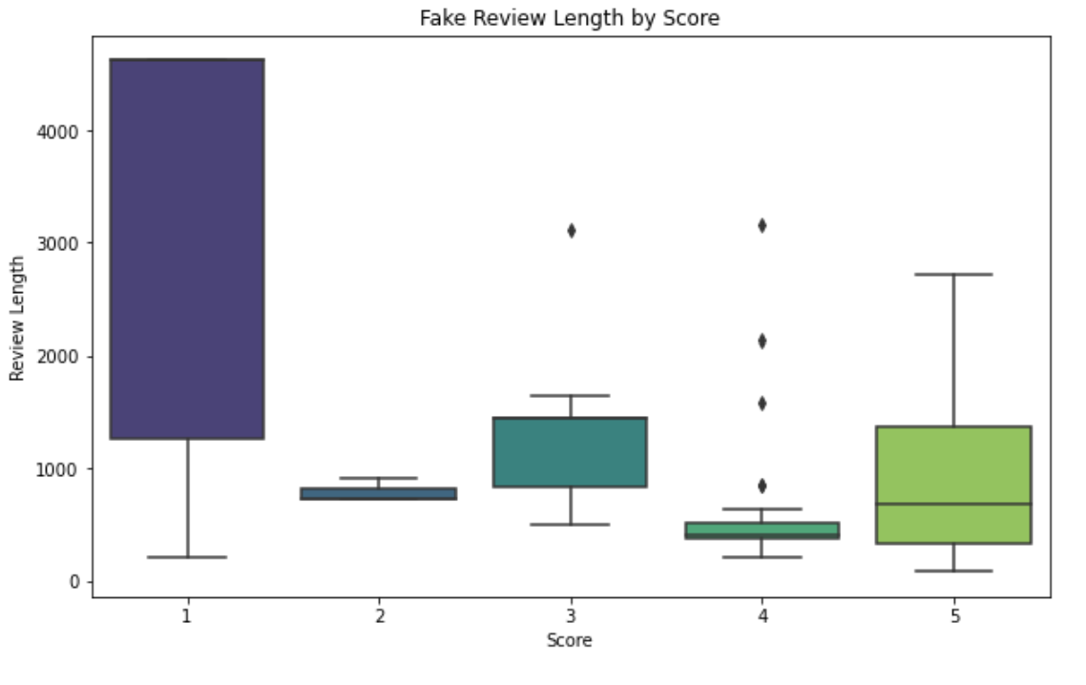
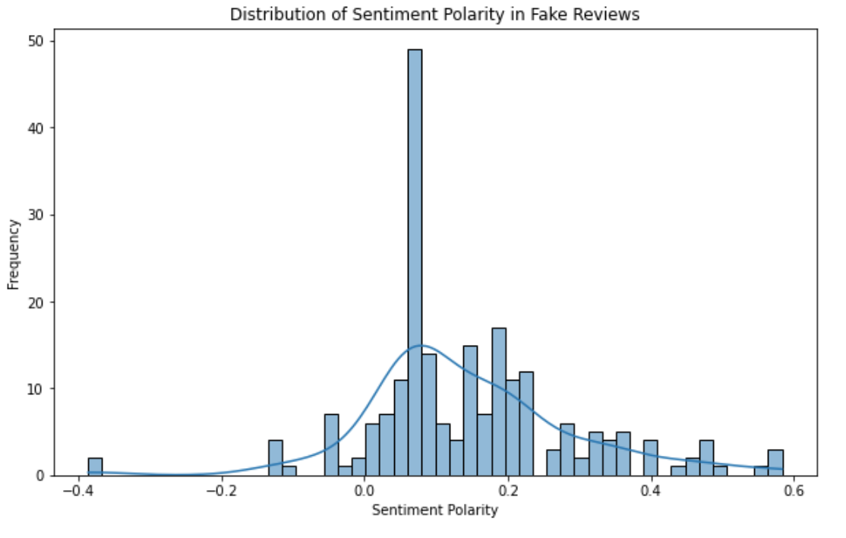
Fake Review Analysis

Slide 8
Conclusion
Numbers in Reviews
HTML tags in Reviews
Duplicate Fake Reviews
Negative Fake Reviews

